Slide 1
MENDELU 2022
Tomas Cejka(CJ), Matej Molnar - STRV

Slide 2

STRV X MENDELU
https://github.com/strvcom/ios-course-mendelu-2022
History
Academy
2 weeks
🖐

Slide 3
NETWORKING

Slide 4
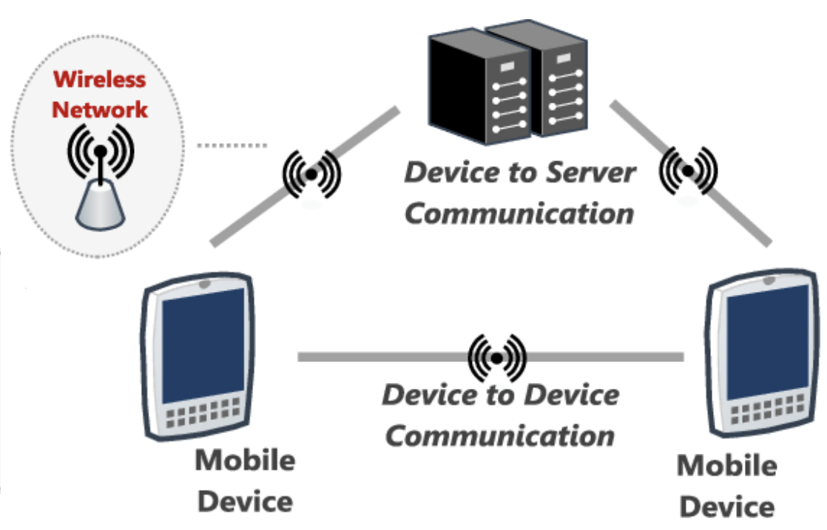
NETWORKING
Important layer
Many tech options & approaches
Our plan
Swift concurrency
API Manager
Rick & Morty

Slide 5
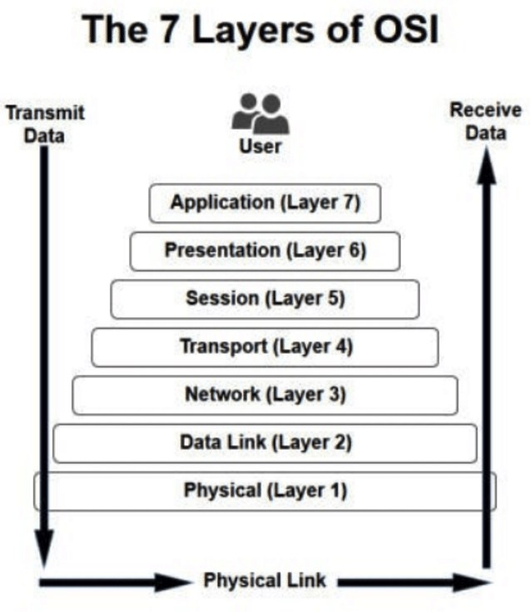
NETWORKING
Request data
Parameters
Methods
Authentication
Receive data
Error handling
Parsing

Slide 6
THANK YOU!
www.strv.com

Slide 7
QUESTIONS

